Slide 1


ElectViz Election Data Visualization for Media
Tools Used: Power BI, DAX, Data Modeling
Presented by: VAISHNAVI.C.S
Institution: INFOSYS VIRTUAL INTERNSHIP

Slide 2

Introduction
Elections generate large volumes of data.
Manual analysis is time-consuming.
Data visualization simplifies interpretation.
Dashboards enable interactive exploration.

Slide 3



Problem Statement
Raw election data is difficult to interpret
No centralized visual reporting
Hard to compare party and region performance
Lack of interactive filtering

Slide 4
Project Objective
To analyze election data effectively.
To visualize voting trends and party performance.
To create interactive and user-friendly reports.
To help in data-driven political analysis.
Compare party-wise performance.
Identify regional voting trends.
Measure voter turnout.
Build an interactive reporting system.

Slide 5
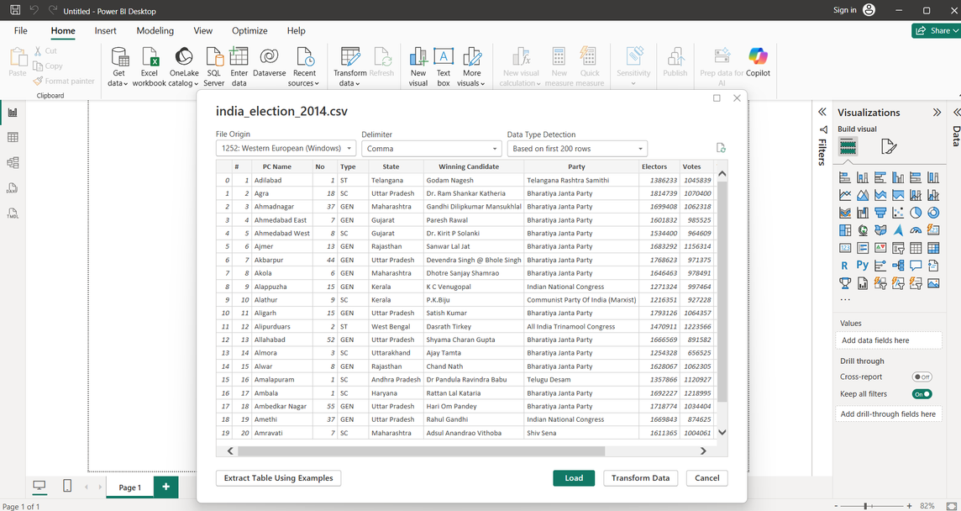
About Power BI
Business Intelligence Tool
Data Cleaning using Power Query
Advanced Calculations using DAX
Interactive Visualizations
Real-time Data Capability

Slide 6
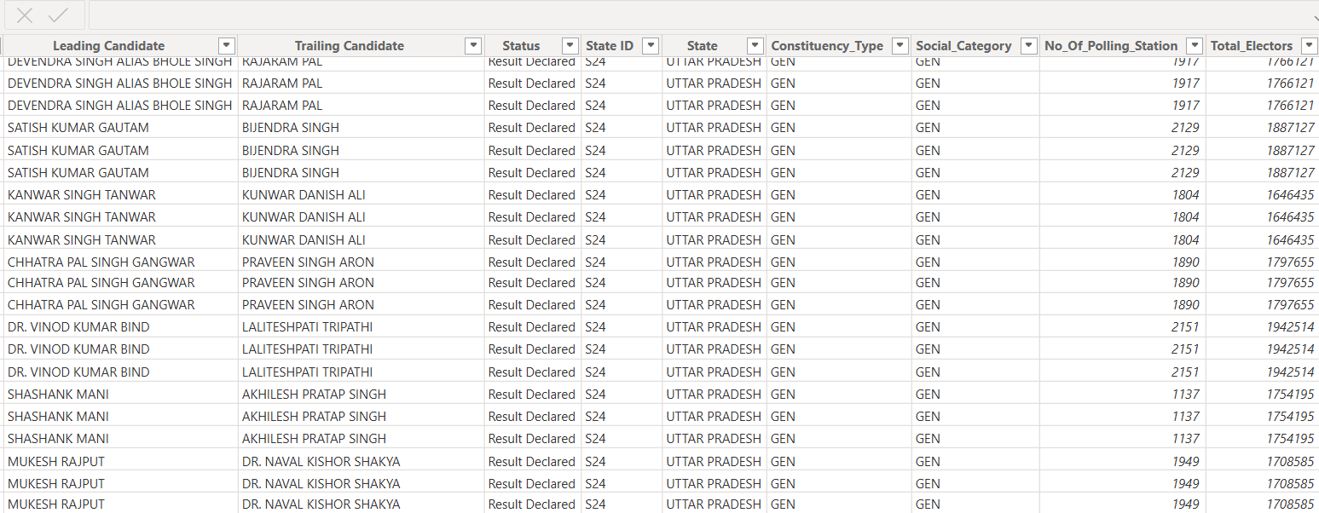
Dataset Overview
Dataset includes:
Candidate Name
Political Party
Constituency
Total Votes
Winning Status
Vote Margin
Voter Turnout %

Slide 7
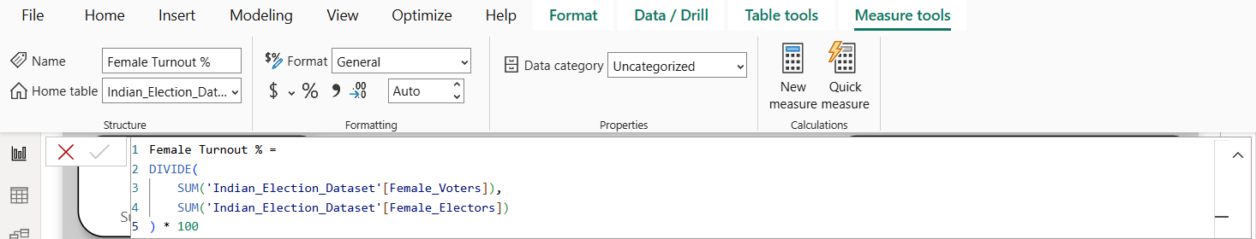
Dataset MOdeling
Created relationships between tables
Implemented Star Schema
Fact Table: Election Results
Dimension Tables: Party, Constituency, Candidate

Slide 8
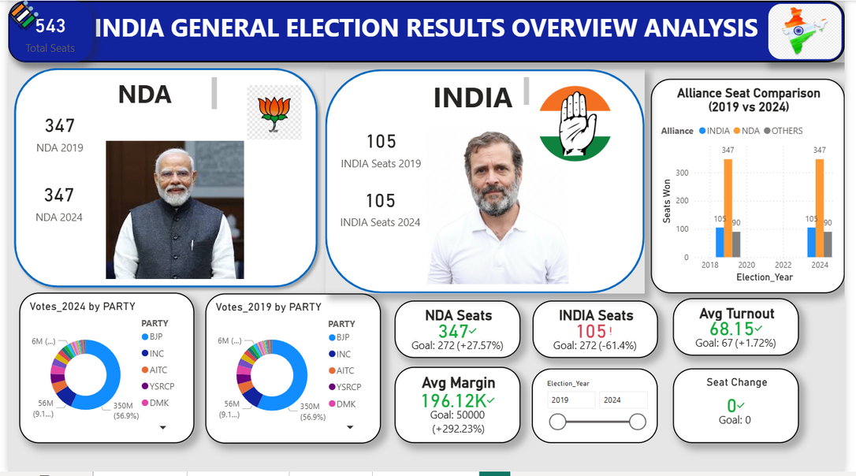
ELECTION DATA Analysis(2019 vs 2024)
Total Seats: 543
NDA: 347 seats (2019) → 347 seats (2024)
INDIA Alliance: 105 seats (2019) → 105 seats (2024)
Others: 90 seats
BJP holds the highest vote share in both years
Average Voter Turnout: 68.15%
Average Winning Margin: 196K votes
Majority seats won with comfortable margins
Overall alliance performance remained stable

Slide 9
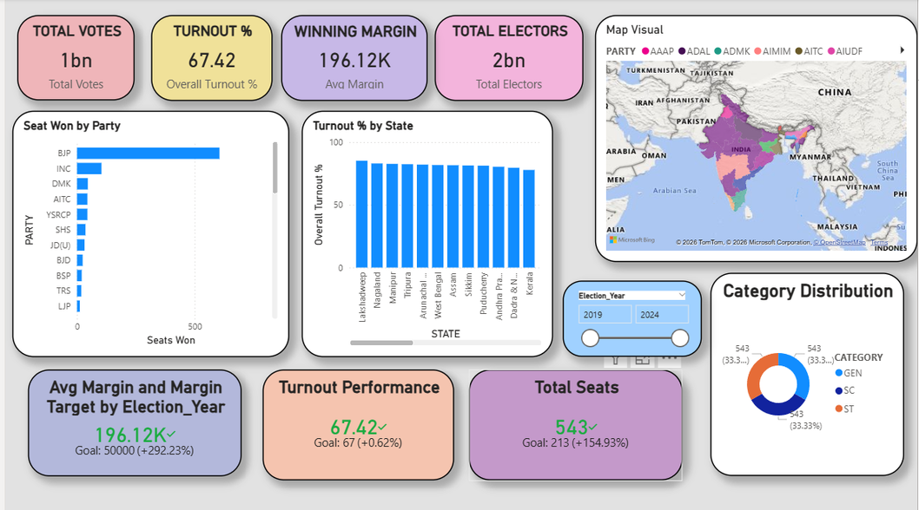
Historical Trends Dashboard
Analyzes election trends across different years to understand voting patterns.
Compares total votes, voter turnout %, and winning margins over time.
Examines seat distribution among major political parties and alliances.
Identifies changes in voter participation and engagement across elections.
Visualizes state-wise voting patterns using map insights.
Shows category-wise seat distribution (GEN, SC, ST).
Helps identify long-term political shifts and historical election patterns.

Slide 10
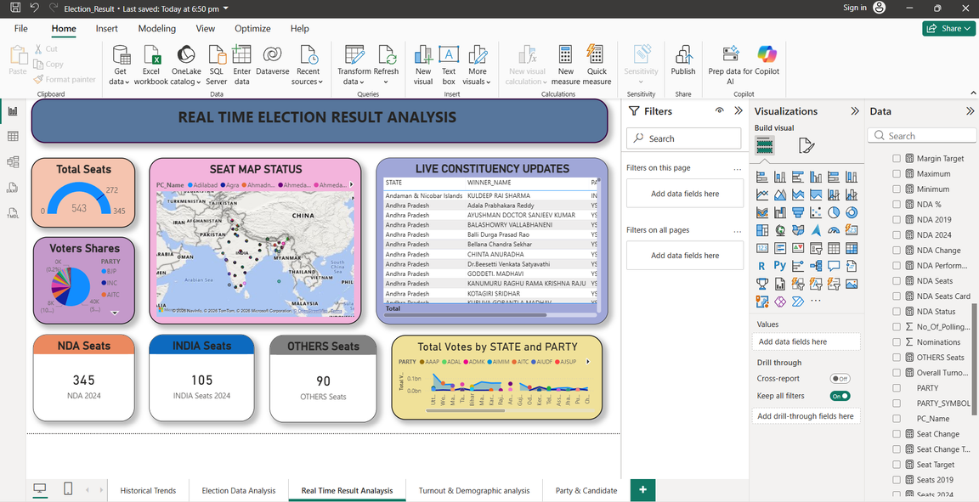
REAL TIME RESULT ANALYSIS Dashboard
Live dashboard tracking 543 total seats across India
NDA leading with 345 seats, followed by INDIA (105) and Others (90)
Interactive map visualization shows constituency-wise status
Voter share chart highlights party-wise vote distribution
State-level trends display total votes by party
Real-time table updates provide winning candidate details
➡ Key Insight:
NDA holds a strong lead with significant dominance across multiple states, as reflected in both seat count and voter share.

Slide 11
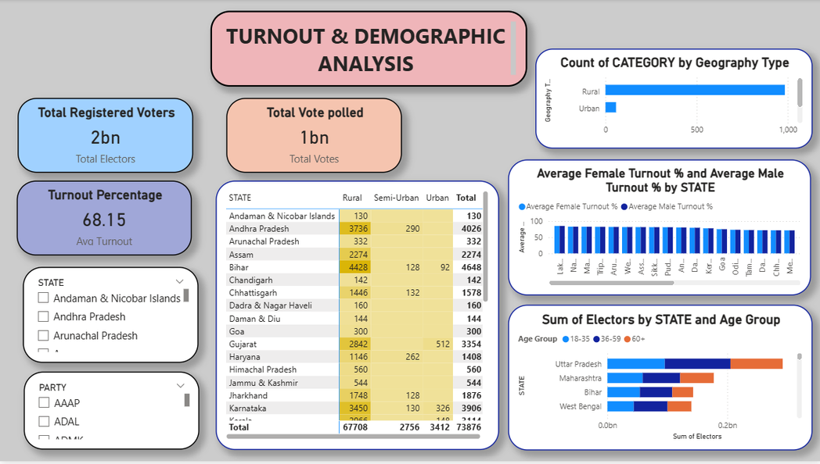
Turnout & Demographic Analysis
Total Votes Polled: 1 Billion
Total Registered Voters: 2 Billion
Overall Turnout: 68.15% (≈ 2/3 of electorate participated)
Rural/Semi-Urban constituencies form the largest share
State turnout range: ~58% to 85%
Gender participation: Male & Female turnout nearly equal
Age distribution: 30–59 years group forms the largest voter base

Slide 12
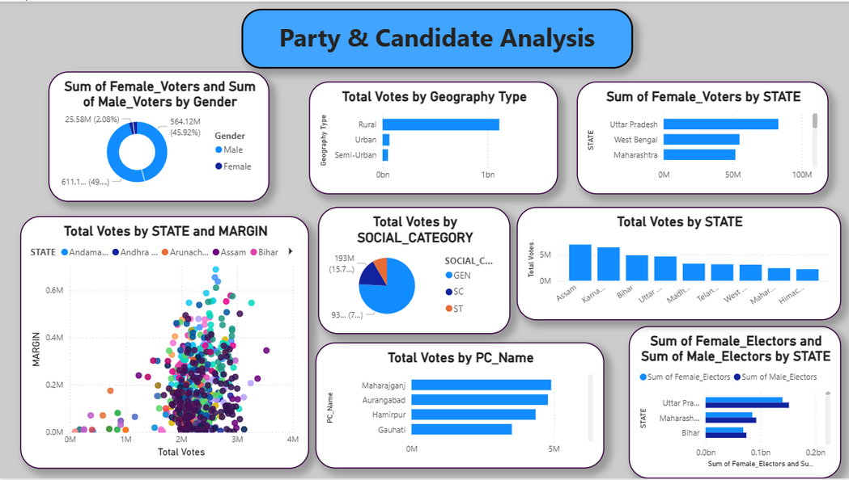
Party & Candidate Analysis
Bar chart showing constituency name by party name.
Pie chart showing voter gap by gender.
scatter chart showing margin by state and total vote polled.
Slicer cards showing geography type and State.

Slide 13
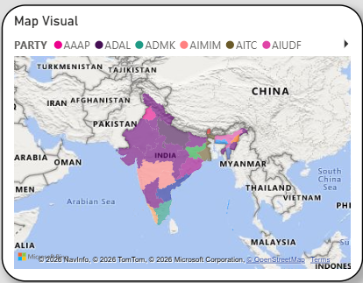
Geographic Map Visualization
State-wise map shows the distribution of winning political parties across India.
Clear regional dominance patterns, with certain parties strong in specific zones.
Some parties have a broader multi-state presence, indicating wider influence.
Highlights the diverse and region-driven nature of electoral outcomes.

Slide 14
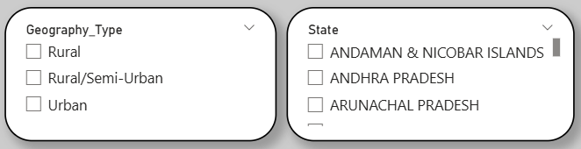
Dashboard Interactivity
Geography Type Filter: Enables analysis by Rural, Rural/Semi-Urban, and Urban constituencies.
State Filter: Allows selection of specific states for focused insights.
Supports customized and comparative analysis across regions.
Enhances decision-making through interactive data exploration.

Slide 15

Key Insights Derived
Party A secured majority seats
Some constituencies had narrow margins
Certain regions show high turnout
Smaller parties have lower vote share

Slide 16

Challenges Faced
Data inconsistency
Complex DAX formulas
Designing user-friendly layout
Performance optimization

Slide 17
Learning Outcomes
Practical Power BI experience
Data modeling knowledge
DAX calculation skills
Dashboard design principles

Slide 18

Future Enhancements
Real-time election updates
Predictive analytics
AI-based trend forecasting
Mobile optimization
-

Slide 19
Conclusion
Successfully transformed raw data
Built interactive dashboard
Applied DAX & Data Modeling
Enabled quick decision-making

Slide 20
THANK YOU
-

